Slide 1
CEM AX Construct
CEM Business Solutions

Slide 2

About Us
Established in 2003
97.7% Customer Satisfaction
12 offices in 8 International Locations
ISO 9001-2008 Certification
Only regional company with CfMD Certification
265 Customers in 19 Industries
Good CSR & Value System
Development Centre in India
Services to
1.Channel
2.End users

Slide 3
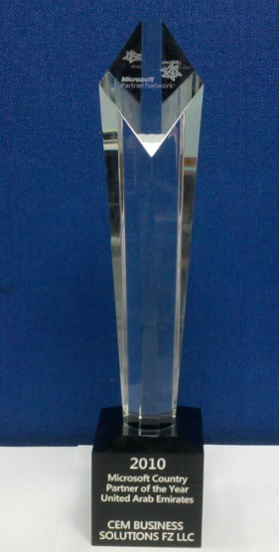


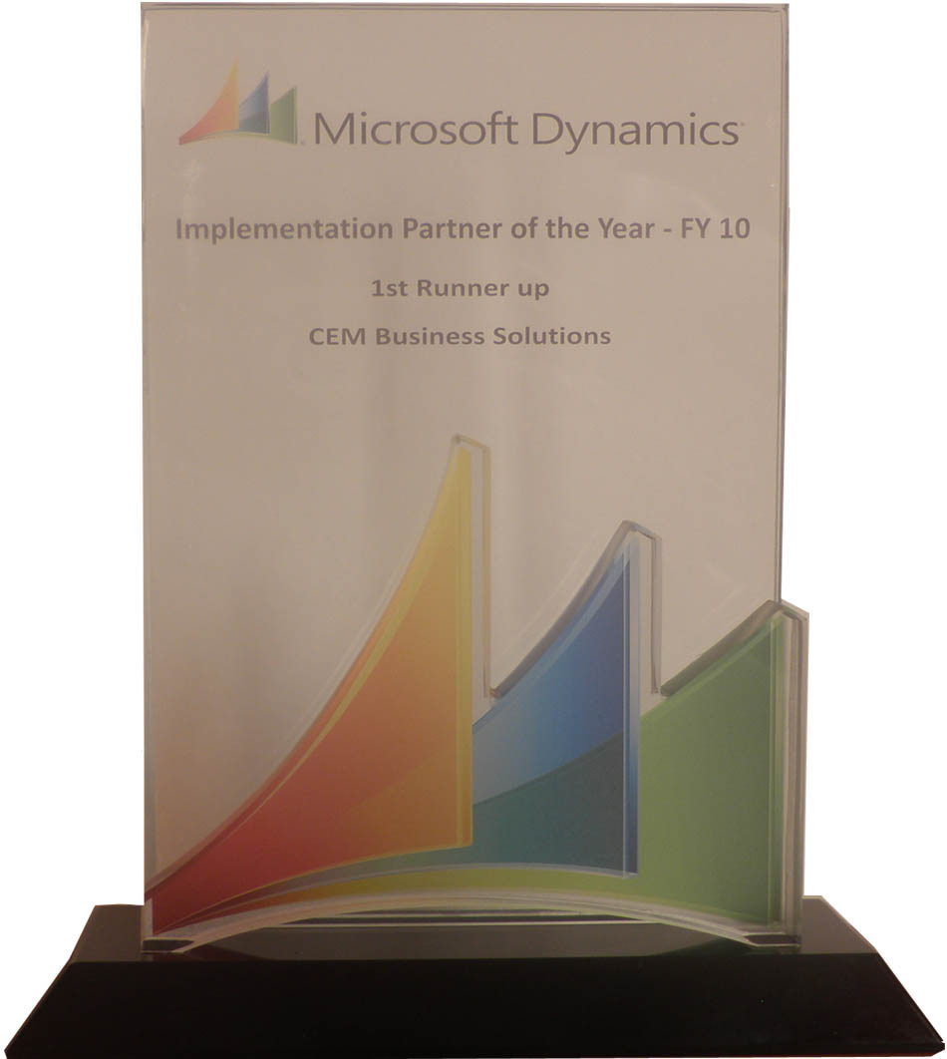
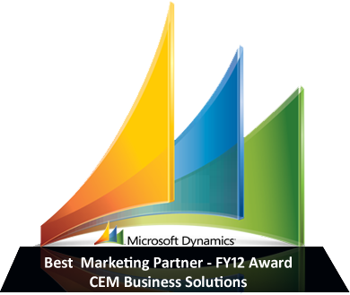
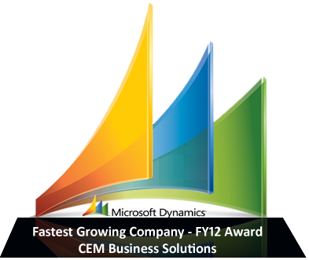
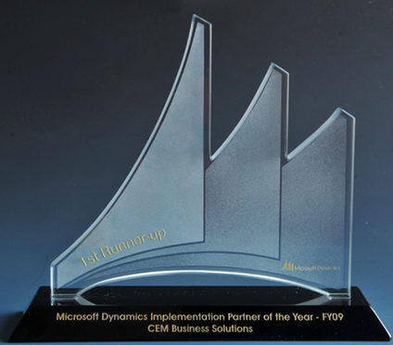


CEM – Microsoft Dynamics Awards
2013 (So Far)
2012
2011
2010
2009
Microsoft Dynamics Awards
Invited Member of
Microsoft Partner Council (MPC)
Partner Advisory Board (PAB)
Enterprise Product Group (EPG)
Member of Microsoft Dynamics AX Council Program
CEM AX Payroll earns CfMD Certification
2012 Microsoft President’s Club Member
Fastest growing Company
Microsoft Best Marketing Partner
Microsoft Best Implementation Partner
2011 Microsoft President’s Club Member
2010 Microsoft Country Partner
Microsoft Best Implementation Partner
2009 Microsoft President’s Club Member
Microsoft Best Implementation Partner
Microsoft Best Sales Partner

Slide 4









Offices
USA
UK
India
UAE
Singapore
Qatar
Kuwait
Oman
12 Offices in 8 International locations

Slide 5
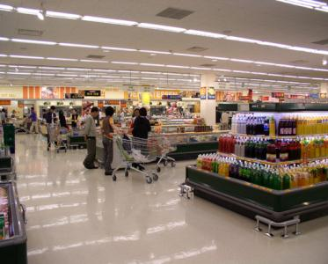
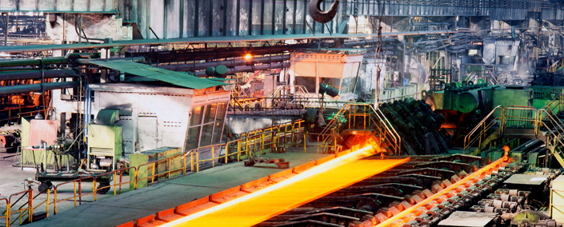
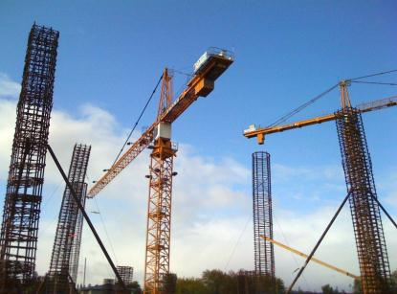



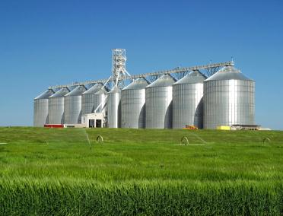


Industries
Construction
Project Services
Facility Management
Food & Beverage
Agriculture
Aviation
Automotive
Marine
Oil & Gas
Insurance
Banking
Manufacturing
Real Estate
Health & Fitness
Transportation
Trade & Logistics
Retail
Equipment Rental
Telecom

Slide 6



CEM Team
Over millions hours of Dynamics experience
Committed to ‘Timely & Quality’ delivery
Qualified people from premium institutes
Onsite / Offshore experience
Incentivized for FTR (First time Right)
Sub contractor experience with large MNCs

Slide 7

CEM AX Construct

Slide 8
Operations Cycle
Customers
Marketing & Sales
Estimation
Planning
Progressive Billing
Projects Monitoring
Services

Slide 9
Industry Requirements
Progress reports to clients
Variance or change requests
Project Accounting
Milestone based billing
Job Costing
Fixed Assets
Fabrication
or Manufacturing
Maintenance
Estimation
HR & Payroll
Workflow & Approvals
Collaboration

Slide 10
Industry Requirements
Interfaces
AutoCAD, Primavera / MS Project or EPS or Excel, Attendance, Weigh bridge, Bar code / RF –ID
Compliance/Approvals/Certifications
Finance & Accounts
Statutory, Periodic, Yield, TB, BS, P&L by Group, company, department, geography, project,
activity, team etc.
Management Information System
HQ / Management reports on time
Business Intelligence
Dashboard, KPI and Balance scorecard

Slide 11
Industry Challenges
Information mismatch from various functions – No single version of facts
Data non availability for reference: Historic, Other projects, Other location, Vendor data
Alerts & reminders – Internal, sub contractors
Skills synchronization & OT
Estimation data challenges
Rush before tender proposal submission
Waste analysis & CVP analysis
Yield optimization
Project progress visibility
Logistics and shipping challenges
Slippages despite Attention To Details
Resourcing – Men and Material
Return inventory invisibility
Statistical Intelligence
Yield data for continual improvement
Data Migration
Audit trail & Security
Information visibility – MIS
Pattern analysis & non repeatability
Assets utilization – Owned & rented
Response time to change request from clients
No uniform codes / masters / convertors / UOM
CR identification & timely alert to customers

Slide 12

Modules – CEM AX Construct
Advanced projects
Management
Advanced Inventory
Management
Ready-Mix Concrete (RMC) purchase
Staff Accommodations
Sub-contract Management
Workforce Augmentation
Plant, Machinery, Vehicle (PMV) Management
Tools Management
(Scaffolding)

Slide 13
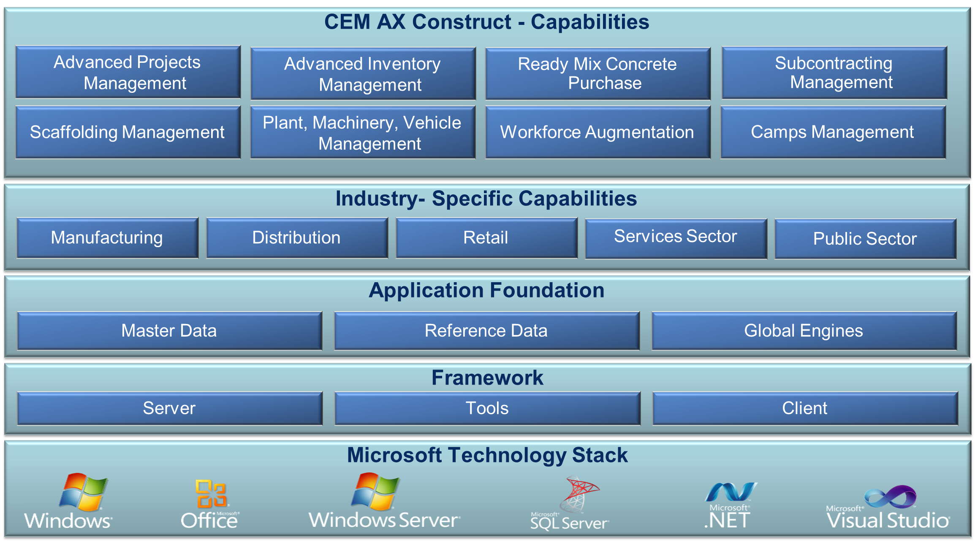
Solution Overview – CEM AX Construct

Slide 14
Process flow – Advanced Project Management

Slide 15
Project Management – CEM Construct
Manage project demographic by creating locations and project clusters
Complete scope management and change management for cost tracking and billing
Project segmentation by tracking the completion stages by control accounts
Quality management with the use of productivity codes for man-power and equipment usage
Secured access for project information and relevant transactions on a need-to-know basis
Extensive reporting such as budget Vs. actuals, consumption by various project dimensions, estimate at complete etc.

Slide 16
Advanced Project Management – CEM Construct
Budget Hierarchies
Create and track budget amounts and variances at various levels such as item category, skills category and cost categories
Control Accounts
Use Control Accounts as a part of Work Breakdown Structure (WBS) to logically arrange project into manageable components for cost tracking with effective dates and reporting
Activate or deactivate the independent control accounts based on the project phase to facilitate accurate information capture
Material Approval
Requests
Ensure that the customer approved items and vendors are applied for the project with the help of Material Approval Requests (MAR)
Track the various MARs with applicable status and validate at the time of entering purchase requisitions or purchase orders for the respective projects

Slide 17
Process flow – Advanced Inventory Management

Slide 18
Advanced Inventory Management – CEM Construct
Categorization of items
Item Creation Wizard
Budgeting by various levels of item hierarchy
Returnable Items Management – Issue and return with projects, vendors and clients
Surplus Declaration
Transit Items Management

Slide 19
Process flow – Concrete Purchase

Slide 20
Ready-mix Concrete (RMV) purchase – CEM Construct
Maintain quality thresholds for part truck load and pumping charges
Maintain optional items along with main concrete items
Summarized and detailed reporting on concrete purchases for invoice certification
Maintain trade agreements for different items with various vendors along with effective dates

Slide 21
Process flow – Sub-contracting Management

Slide 22
Sub contract Management – CEM Construct
Track and manage subcontract related documents such as performance bond, warrantees etc.
Track material issues and food & accommodation expenses related to subcontracts for prompt back charging.
Manage subcontract scope, scope breakup, payment milestone and variation orders
Track advances and retentions
Track invoicing against scope and scope details

Slide 23
Process flow – Scaffolding Management

Slide 24
Scaffolding Management – CEM Construct
Manage purchasing and hiring of scaffold
Manage trade agreements for purchase, hire and discounts
Better utilization of internal materials
Scrap, lost management of materials
Flexible and controlled receipt management
Track vendor invoices & have better control and reconciliation
Analyze the scaffold logistics from the list of requested items to invoiced items

Slide 25
Process flow – PMV Management

Slide 26
(Plant, Machinery, Vehicle) PMV Management – CEM Construct
Regular alerts for equipment related documents like registration,license,security pass, warranty period expiration, etc.
Equipment hire renewal with history
Manage Equipment Purchase & Hiring
Maintain and track equipment log sheet
Trade agreements for both internal & external hire
Integration of PMV with fixed assets module
Manage mobilization / demobilization costs of equipment hire
Track fuel consumption
Equipment transfer history

Slide 27
Process flow – Man power Augmentation

Slide 28
Man power Augmentation – CEM Construct
Maintain trade agreements for labour supply with effective dates
Integration with Payroll like creating a separate ID and Maintain timesheets for hired employees , project-wise
Track the food & accommodation of hired employees for prompt back charging
History of hired employees and option for purging the hired employee details
Certify use payment certification process for approving vendor invoices

Slide 29
Process flow – Workforce Accommodation

Slide 30
Camps/Workforce Management – CEM Construct
Link internal camps with an internal project to track
the operating expenses and matching against the
transfer price revenue
Track the meals consumed by occupants by type. Optionally, enter and post deductions or additional
meal transactions based on the actual consumption of food coupons
Activate the logging routine and generate daily
camp register to track which occupant's cost should be assigned to which project, on a daily basis
Maintain rooms, room category, capacity and availability of each and every room of the camp
Manage the occupants’ food expenses
Manage trade agreements for caterers to facilitate accurate cost booking
Convenient user experience for check in & check out of occupants
Manage your camp capacity, accommodation of diversified occupants and guests
Cost allocations to respective projects

Slide 31
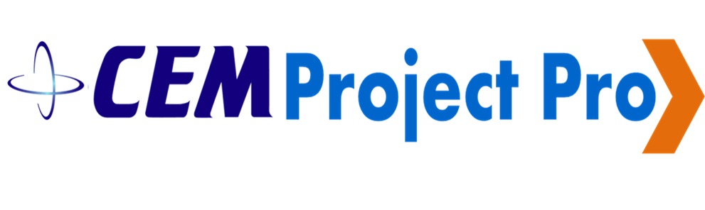
Project Pro

Slide 32

CEM Project Pro
Caters analysis for both Top Management as well as Planners
Upon collecting progress figures, entire report and multitude of analysis reports can be prepared within half-an-hour, whereas it requires few days in Primavera for large projects
Progress can be updated in CEM Project Pro by a secretary thereby saving planner's time. Progress reports can be prepared by secretary itself. Number planners required for the company can be drastically reduced

Slide 33
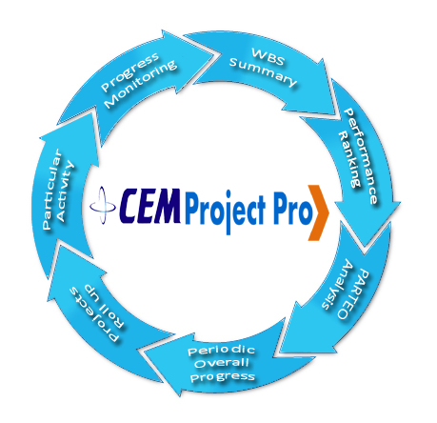
Features of CEM Project Pro
Progress Monitoring
WBS Summary
Performance Ranking
Root cause PARETO Analysis
S CURVES
Periodic Overall Progress
Projects roll up for a particular activity

Slide 34
Extension to existing modules
Fixed assets
FA code creation wizard
Budget Validation
Purchase Request – An item level and item group level
Project Accounting
Productivity codes – to measure activity performance and grading
Validations in change orders based on contracts terms
Project specific document number sequences
Inventory
Additional Item categories
Item master creation wizard
Virtual warehouse for tracking in transit
Customer restrictions to merge multiple purchase requested into one purchase order
Other Enhancements
Payment authorization for all custom module transactions
Integration enhancement between Fixed Assets, Payables and other Custom Modules
Export to excel facility for reports
Role–specific dashboards & Record based security
100+ reports on financials, cost controls, project metrics

Slide 35
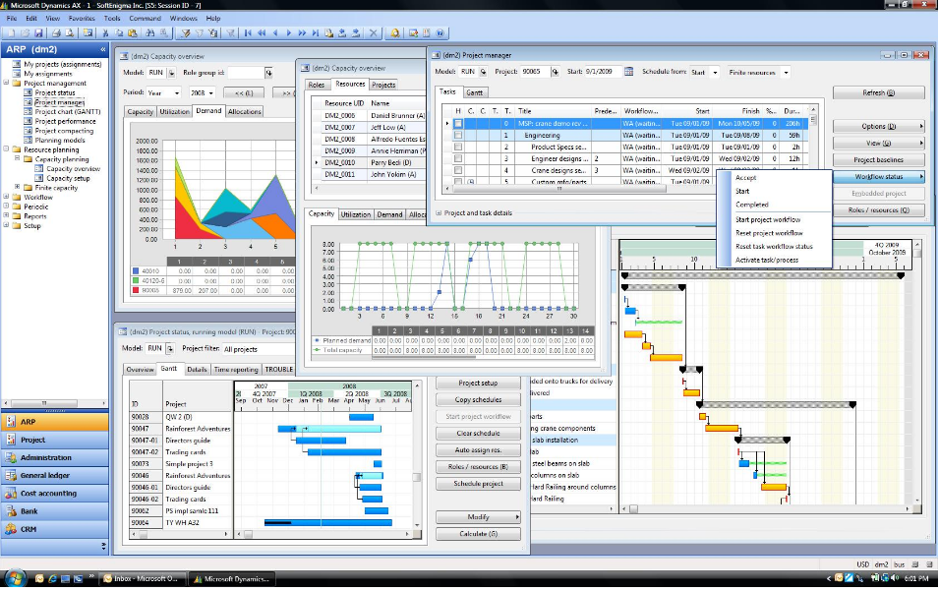
Industry Unique Dashboards

Slide 36

CEM Case Studies

Slide 37
Granite Construction Company
Product Version | Microsoft Dynamics AX (2012)
Website | www.graniteuae.com
Industry | Construction
Sub Industry | Construction, Operational services for Oil and Gas Industry
Modules Implemented | Finance, Contracts, Estimation, Job costing, Purchase, Inventory, Project accounting, HR & Payroll, Multi currency, MS Project Server Integration, Consolidation
Platform | Private Cloud
Add on Modules | Scaffolding, Camp, Concrete, Equipment, Rental, 150 unique reports, 15 unique dashboards
Implementation Methodology | Sure Step

Slide 38
Ascorp Industries
Product Version | Microsoft Dynamics AX2012
Website | www.ascorpuae.com
Industry | Construction
Sub Industry | Construction, Real Estate, Building Block, Manufacturing & Rental
Modules Implemented | Finance, Sales, Purchase, Inventory, Manufacturing, Project Accounting Multi country, Multi currency, Group Companies Consolidation & Rental
Platform | On Premises Server
Implementation Methodology | SureStep

Slide 39
Control & Applications Emirates
Product Version | Microsoft Dynamics AX2009 & CRM
Website | www.caeme.com
Industry | EPC – Engineering Procurement and Contracting
Sub Industry | Oil & Gas, Petrochemical & refineries, Power & Water, Infrastructure
Modules Implemented | Finance, Sales (Contracts), Purchase, Inventory, Project Accounting, MS Project Server integration, Multi country, Multi currency, Group companies consolidation
Platform | On Premises Server
Implementation Methodology | SureStep
Note: Consolidation of 21 companies from many countries

Slide 40
CGC
Product Version | Microsoft Dynamics AX 2012
Website | www.cgulfc.com
Industry | Contracting
Sub Industry | Sub-contracting & General Contracting
Modules Implemented | Finance, Sales (Contracts), Purchase, Inventory, Project Accounting, MS Project Server integration, Multi country, Multi currency, Group companies consolidation
Platform | On Premises Server
Implementation Methodology | SureStep

Slide 41
Terraseis
Product Version | Microsoft Dynamics AX (2009)
Website | www.terraseis.com
Industry | Oil & Gas
Sub Industry | Exploration, Geo-physical
Modules Implemented | Projects , Finance, Sales, Purchase, Inventory, Project Accounting Multi country, Multi currency, Group Companies Consolidation
Platform | On Cloud
Implementation Methodology | SureStep

Slide 42
Alam Steel
Product Version | Microsoft Dynamics AX 2012
Website | www.alamsteel.co
Industry | Projects
Sub Industry | Fabrication, Sub-Contracting
Modules Implemented | Projects , Finance, Sales, Purchase, Inventory, Project Accounting Multi country, Multi currency, Group companies consolidation
Platform | On Premise
Implementation Methodology | SureStep

Slide 43

Why CEM?
Domain expertise in 19 Industry Verticals
97.7% Customer Satisfaction
End-to-end service from implementation to support
Over Million hours of Microsoft Dynamics experience
24x7 Operations
Microsoft Dynamics’ Best implementation partner 3 years in a row
265 Happy Customers
Proven “Sure Step Methodology”
Successful timely project completion
Lower TCO (Total cost of ownership) by blended model

Slide 44

Contact Us
United States
50 Tice Blvd, Suite 340
Woodcliff Lake, NJ 07677
Tel : +1 201 690 5270
4944 Sunrise Blvd. Suite B-4,
Fair Oaks, CA 95628
Tel : +1 916 799 4029
United Kingdom
4 Morel Mews, Dagenham RM8
1 BW Essex
Tel : +44 207 993 6483
Singapore
10 Anson Road,
#26-04 International Plaza,
Singapore 079903
Tel : +65 9757 576
United Arab Emirates
119, Building No. 10, Dubai
Internet City, P.O. Box 502270,
Dubai, U.A.E. Tel : +971 4 3911683
1403, AI Zahra Tower,
King Faisal Street, Sharjah, U.A.E.
Tel : +971 6 5734700
Kuwait
P.O. Box 36350, AI Rass 24754, Kuwait,
Tel : +965 - 22622063
Qatar
P.O. Box #51, Doha Qatar
Tel: +974 300 75 145
India
No:85, Babu Street, Vellala,
Teynampet, Chennai 600 086
Tel : +91 44 33083800

Slide 45
Thank You

